Slide 1
Broadcasting Chat Server Based On Java
Under the guidance of:
Sakifa Aktar
Assistant Professor
Dept. of CSE ,BSMRSTU
Submitted by-
Anup Ghosh (18ICTCSE050)
MD Sohanur Rahaman (18ICTCSE052)
Dept. of CSE , BSMRSTU
Session : 2018-19
Semester : 4th

Slide 2
Content
Introduction
Objective
Features
Design
Implementation
Important Code Section
Screenshots
Future Enhancement

Slide 3
Introduction
This is a chat server which is a computer program or application that facilitates real-time communication between client over a network.
It acts as a central hub or intermediary, allowing clients to connect, exchange messages, and participate in conversations with each other.
The chat server typically operates on a client-server architecture, where the server program is running on a dedicated machine with a known network address, and clients connect to it using client software.

Slide 4
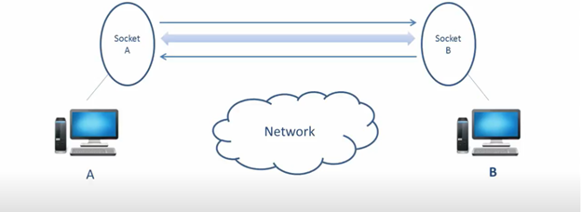
Objective
In this project we can chat with the server as a client.
This project also includes image sharing system between server and client.
This project is mainly used to communicate with the server inside a network.
It can be used through two different devices.
It is more secured for personal or a limited group of user.

Slide 5
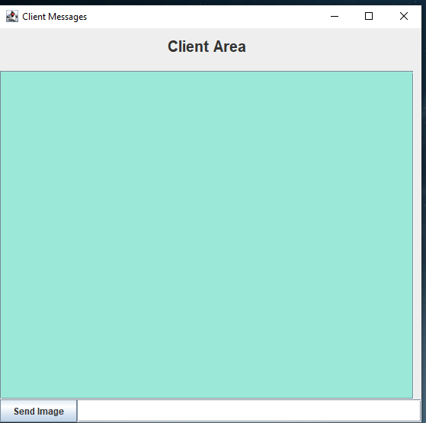
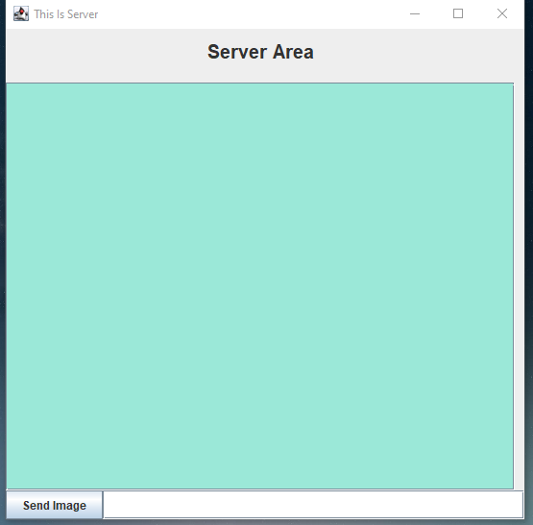
Features
This project provides two different Interface for client and server.
Each Interface has text field , texting area .
Also in each interface there is a extra panel to the east for showing images that is send by the server to the client and vise versa.
In the bottom of each interface there is a button to send image.

Slide 6
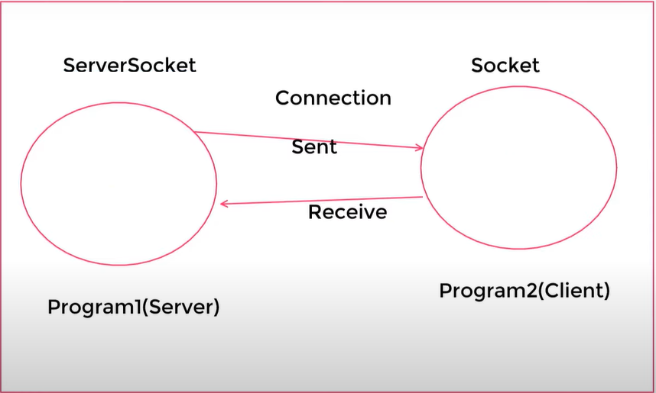
Design
We can easily understand the Design of the project by the picture.
In this there is two program , the server and the client.
When the server is active then client can sent request for connection.
The server receive connection and establish a ServerSocket connection between them.

Slide 7
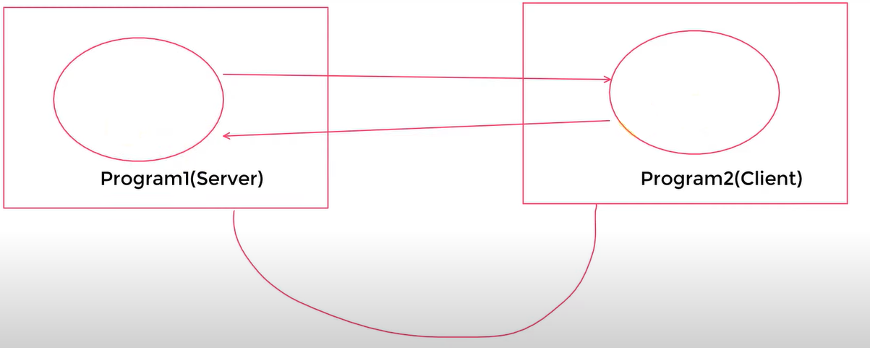
Design
It is not necessary that the client and server must be in one device .
We can use two computer for establish the connection.
But in this case both PC must be in the same network.

Slide 8
Implementation
The project is mainly based on java.
Java Socket networking is the core of this project.
The Interface/UI is implemented by Java Swing.
The connections are established by TCP/IP networking protocol.
There use multithreading for sending and receiving messages thoroughly.

Slide 9
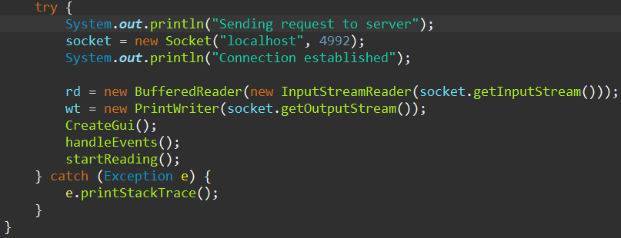
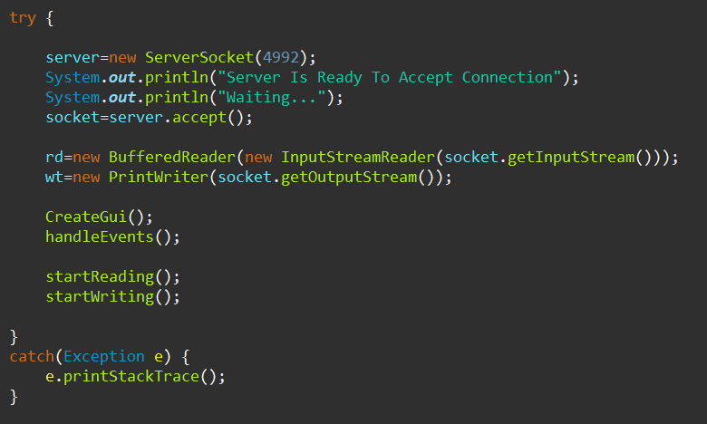
Important Code Section
Client Area Connection
Server Area Connection

Slide 10
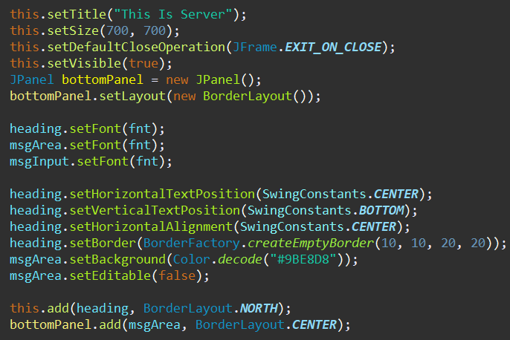
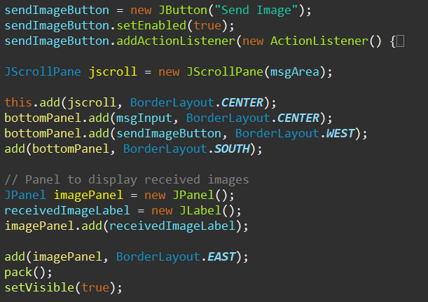
Creating GUI

Slide 11
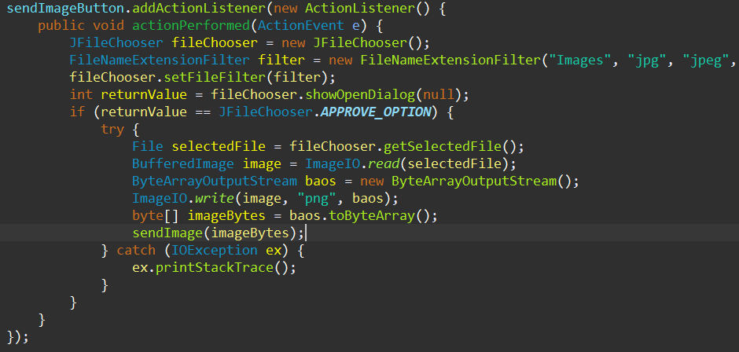
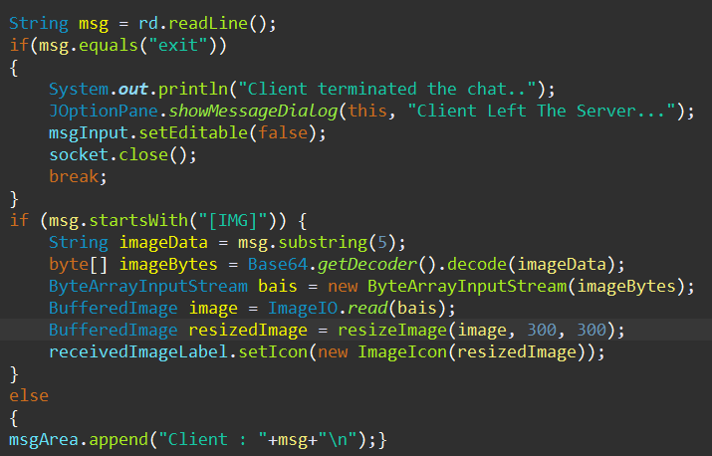
For Image and Text
For Choosing and sending Image
For Receiving and Showing message and picture

Slide 12
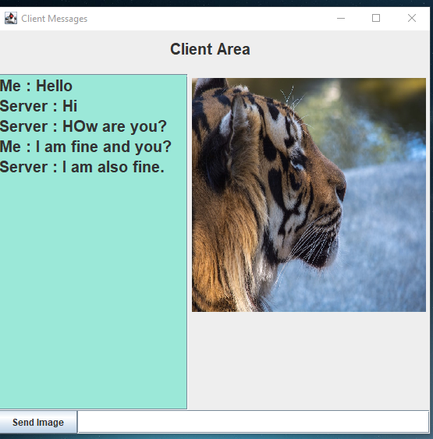
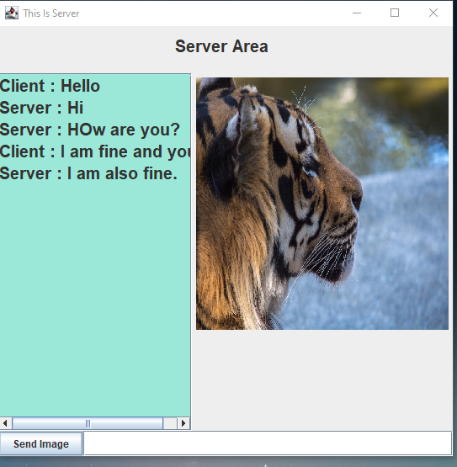
Screenshots of final output

Slide 13
Future Enhancement
In future we will update the module so that we can communicate in different network.
Also we can update the module so that we can chat groupwise.

Slide 14
Thank You Everyone

